Slide 1
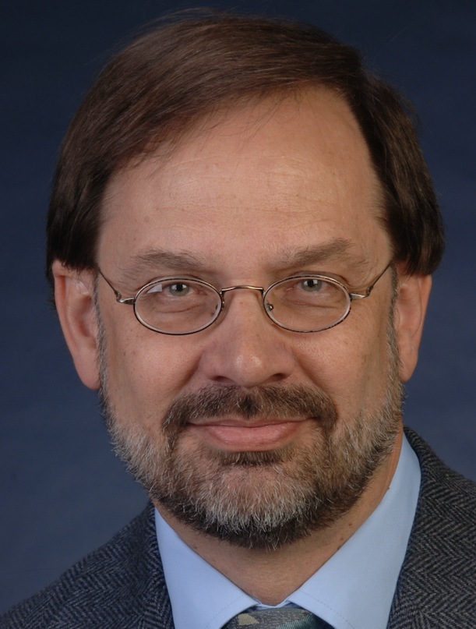

International Collaboration for Open Data and Open Science
Robert Hanisch
Director, Office of Data and Informatics
Material Measurement Laboratory
National Institute of Standards and Technology
Tuesday July 24, 2018

Slide 2
A Bit About Me
PhD in radio astronomy
Thirty years at the Space Telescope Science Institute, Baltimore, Maryland
Calibration and analysis software for Hubble Space Telescope
HST and NASA Multi-Mission data archives
Image restoration
Chief Information Officer
Project Manager, then Director, US Virtual Observatory
Four years at NIST
Director, Office of Data and Informatics

Slide 3
Virtual Observatory (VO)
Distributed but federated data system; data is managed and curated by the organizations that produce it
Integrated discovery and access to astronomical data worldwide
Built on internationally agreed suite of data access protocols
Participation does not require data providers to modify anything about their data management infrastructure

Slide 4
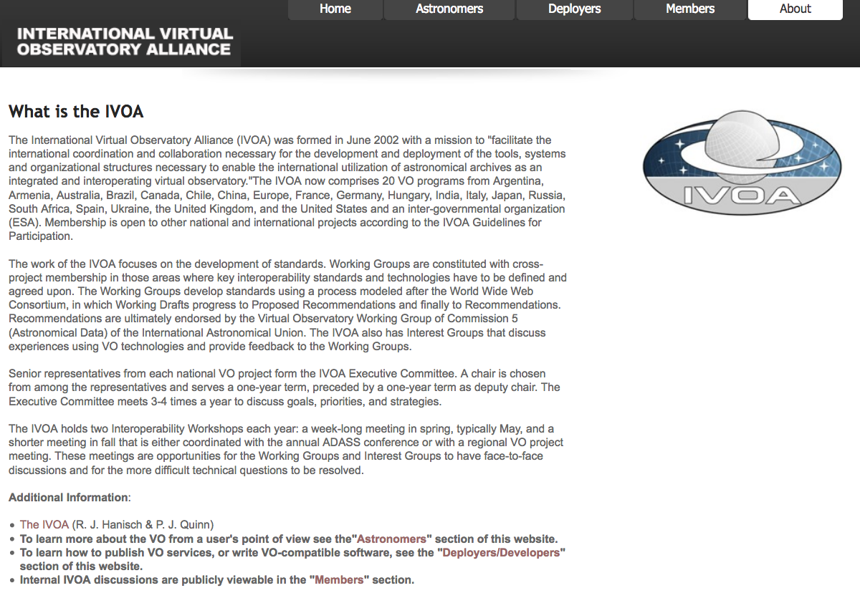
International Virtual Observatory Alliance
http://www.ivoa.net

Slide 5
IVOA Origins
1998-1999: “Virtual Observatory” concept arises in the US National Academy’s decadal survey for astronomy
2000: June, US National Virtual Observatory collaboration
2000: August, IVOA formed, Garching, Germany
US (NVO), UK (AstroGrid), EU/ESO (AstroVirtel)
2002: January, first technical meeting, Strasbourg; October, second technical meeting, Baltimore, Cone Search protocol defined

Slide 6

IVOA Members

Slide 7
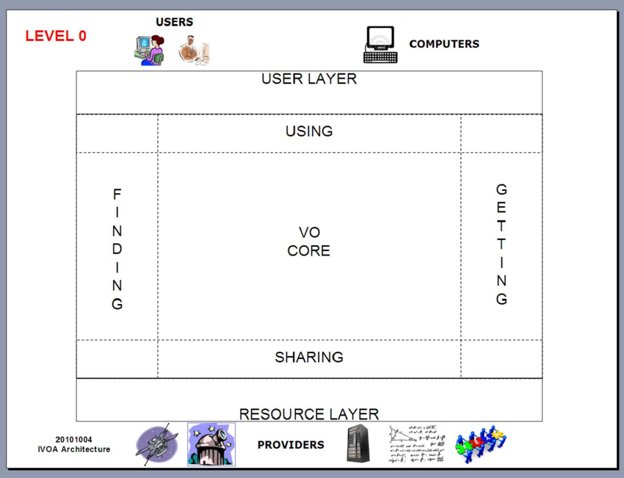
VO Architecture

Slide 8
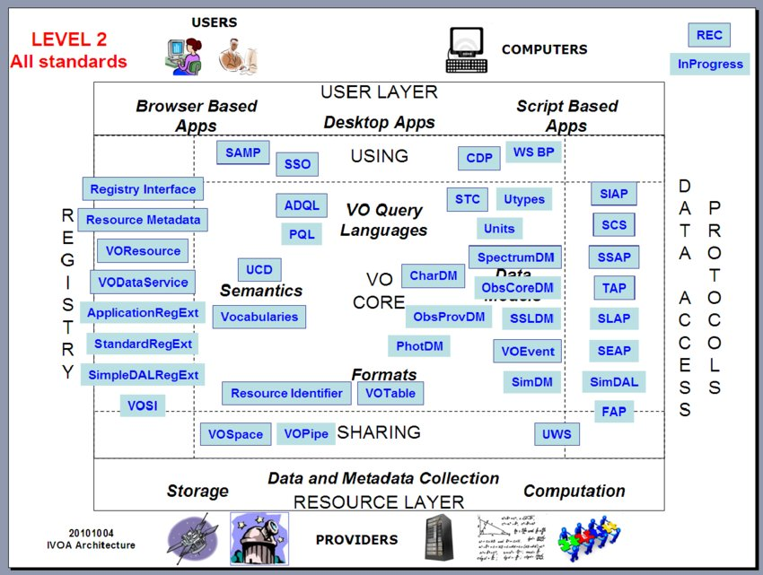
VO Architecture

Slide 9
VO Protocols
SCS: Simple Cone Search
SIAP: Simple Image Access Protocol
SSAP: Simple Spectrum Access Protocol
SLAP: Simple Line Access Protocol
SEAP: Simple Event Access Protocol
TAP: Table Access Protocol
SAMP: Simple Application Messaging Protocol

Slide 10
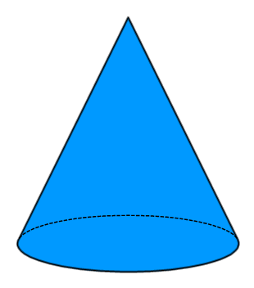
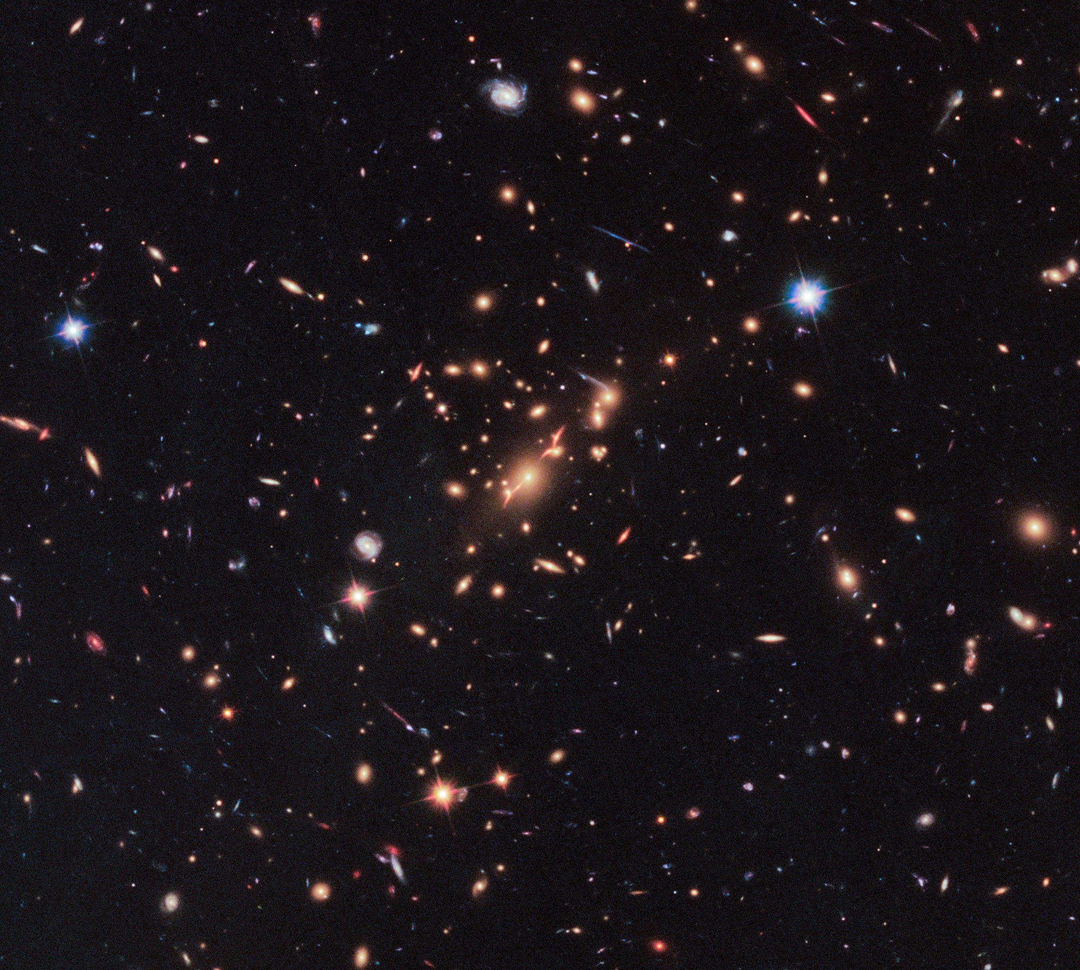

Cone Search, Image Access
r
𝛼, 𝛿
𝛼₁, 𝛼₂, 𝛿₁, 𝛿₂

Slide 11
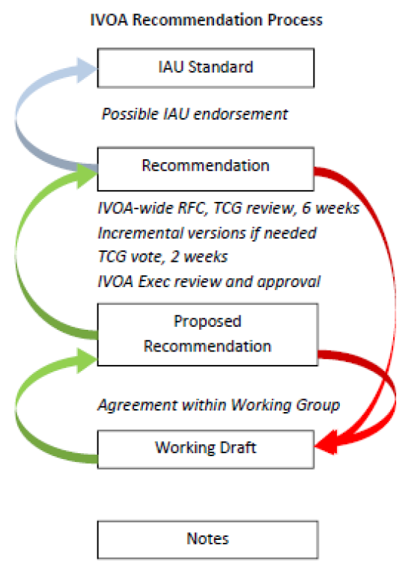
IVOA Protocol Development Process
Adapted from W3C
Recommendations require at least two independent implementations as demonstration of interoperability

Slide 12
IVOA Funding and Governance
No central funding; aggregate of national funding over ~20 years: ~$50M
Each national project contributes effort according to national priorities and resource availability; US NVO/VAO projects co-sponsored by NSF and NASA. ~$15M over 10-12 years
Two “Interop” meetings per year, 40-80 participants
Website and document collection operated by one or two national projects
Technical efforts conducted in Working Groups, coordinated by “TCG”
Executive Committee has senior management representative from each national project; chair is elected and serves 18-month term
Decision-making is by consensus

Slide 13
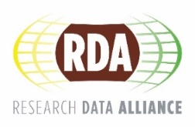
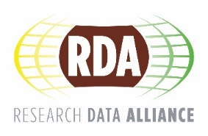
THE RESEARCH DATA ALLIANCE
www.rd-alliance.org
building the social and technical bridges that enable open sharing of data
Vision
Researchers and innovators openly share data across technologies, disciplines, and countries to address the grand challenges of society.
Mission
RDA builds the social and technical bridges that enable open sharing of data.
24 FLAGSHIP OUTPUTS
of which 4 ICT Technical Specifications
75 ADOPTION CASES
across multiple disciplines, organisations & countries
93 GROUPS WORKING ON GLOBAL DATA INTEROPERABILITY CHALLENGES
of which 32 WORKING GROUPS
& 61 INTEREST GROUPS
7,086 INDIVIDUAL MEMBERS FROM 137 COUNTRIES
67% Academia & Research
15% Public Administration
11% Enterprise & Industry
44 ORGANISATIONAL MEMBERS &
8 AFFILIATE MEMBERS
CC BY-SA 4.0

Slide 14
What is RDA?
RDA is an international member based organization focused on the development of infrastructure and community activities that reduce barriers to data sharing and exchange, and the acceleration of data driven innovation worldwide. With more than 7,000 members globally representing 137 countries, RDA includes researchers, scientists and data science professionals working in multiple disciplines, domains and thematic fields and from different types of organisations across the globe.
RDA is building the social and technical bridges that enable open sharing of data to achieve its vision of researchers and innovators openly sharing data across technologies, disciplines, and countries to address the grand challenges of society.
CC BY-SA 4.0

Slide 15
What Does RDA Do?
Members come together through self-formed, volunteer, focussed Working Groups, exploratory Interest Groups to exchange knowledge, share discoveries, discuss barriers and potential solutions, explore and define policies and test as well as harmonise standards to enhance and facilitate global data sharing & re-use.
RDA members collaborate together across the globe to tackle numerous infrastructure & data sharing challenges related to:
Reproducibility
Data preservation
Best practices for domain repositories
Legal interoperability
Data citation
Data type registries
Metadata
and so many more!
CC BY-SA 4.0

Slide 16

Who Can Join RDA?
Any individual or organization, regardless of profession or discipline, with an interest in reducing the barriers to data sharing and re-use and who agrees to RDA’s guiding principles of:
Openness
Consensus
Balance
Harmonization
Community-driven
Non-profit and technology-neutral
Individual Membership is free @ https://www.rd-alliance.org/user/register
CC BY-SA 4.0

Slide 17
Why Join RDA as an Individual Member?
Individual Member Benefits
Contribute to acceleration of data infrastructure development
Work and share experiences with collaborators throughout the world
Access to extraordinary network of colleagues with various levels of experience, perspectives and practices
Gain greater expertise in data science regardless of whether one is a student, early or seasoned career professional
Enhance the quality and effectiveness of personal work and activities
Improve one’s competitive advantage professionally and positioning oneself for leadership within the broader research community
Individual RDA Members 7,086
CC BY-SA 4.0

Slide 18
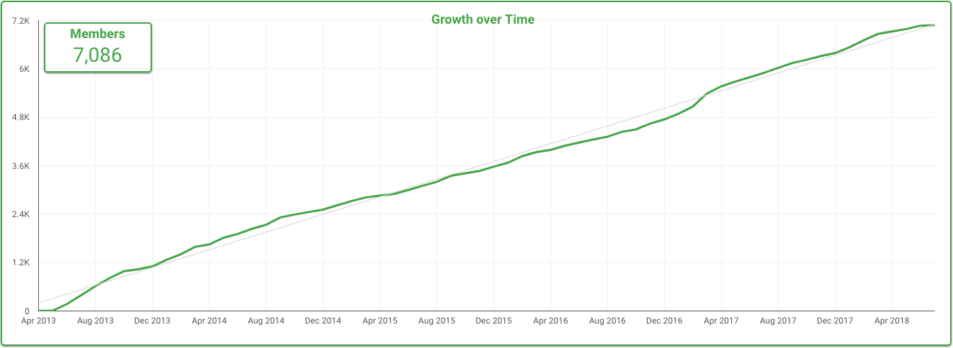
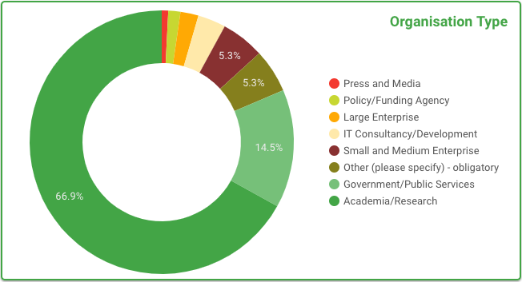
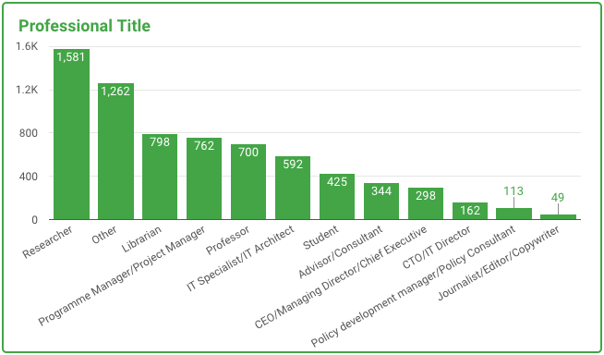
RDA Worldwide Growth
CC BY-SA 4.0
Notes:
Guiding Principles:
Openness
Consensus
Balance
Harmonization
Community-driven
Non-profit and technology-neutral

Slide 19
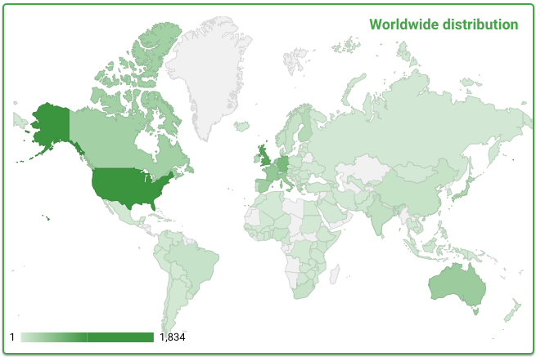
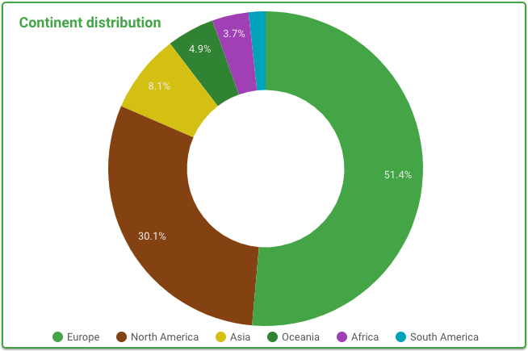
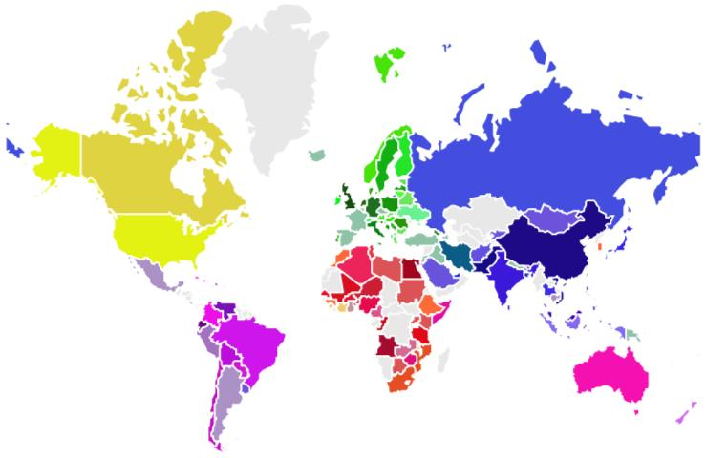
RDA Distribution
RDA members come from 137 different countries
CC BY-SA 4.0
Notes:
Guiding Principles:
Openness
Consensus
Balance
Harmonization
Community-driven
Non-profit and technology-neutral

Slide 20
RDA Interest (IG) & Working Groups (WG) by Focus (1)
Domain Science - focused
Agrisemantics WG
BioSharing Registry WG
Blockchain Applications in Health WG
Capacity Development for Agriculture Data WG
Fisheries Data Interoperability WG
On-Farm Data Sharing (OFDS) WG
Rice Data Interoperability WG
Wheat Data Interoperability WG
Persistent Identification Instruments WG
Agricultural Data IG (IGAD)
Biodiversity Data Integration IG
Chemistry Research Data IG
Digital Practices in History and Ethnography IG
Earth, Space, and Environmental Sciences IG
Geospatial IG
Global Water Information IG
Health Data IG
Linguistics Data Interest Group
Mapping the Landscape IG
Marine Data Harmonization IG
Quality of Urban Life IG
RDA/CODATA Materials Data, Infrastructure & Interoperability IG
Research data needs of the Photon and Neutron Science community IG
Small Unmanned Aircraft Systems’ Data IG
Structural Biology IG
Weather, Climate and air quality IG
From Observational Data to Information IG
Total 93 groups:
32 Working Groups & 61 Interest Groups
Partnership Groups
RDA / TDWG Metadata Standards for attribution of physical and digital collections stewardship WG
RDA/WDS Scholarly Link Exchange Working Group
ELIXIR Bridging Force IG
RDA/NISO Privacy Implications of Research Data Sets IG
RDA/WDS Publishing Data IG
CC BY-SA 4.0

Slide 21
RDA Interest (IG) & Working Groups (WG) by Focus (2)
Total 93 groups:
32 Working Groups & 61 Interest Groups
Reference and Sharing - focused
Data Citation WG
Data Description Registry Interoperability WG
Data Security and Trust WG
Empirical Humanities Metadata WG
International Materials Resource Registries WG
Provenance Patterns WG
Storage Service Definitions WG
RDA / WDS Publishing Data Bibliometrics WG
Repository Core Description WG
Research Data Collections WG
Research Data Repository Interoperability WG
Data Usage Metrics WG
Data Discovery Paradigms IG
National Data Services IG
RDA/CODATA Legal Interoperability IG
Reproducibility IG
Sharing Rewards and Credit (SHARC) IG
Community Needs - focused
Certification and Accreditation for Data Science Training and Education WG
RDA/CODATA Summer Schools in Data Science and Cloud Computing in the Developing World WG
Teaching TDM on Education and Skill Development WG
CODATA/RDA Research Data Science Schools for Low and Middle Income Countries
Archives & Records Professionals for Research Data IG Data for Development IG
Development of Cloud Computing Capacity and Education in Developing World Research IG
Early Career and Engagement IG
Education and Training on handling of research data IG
Ethics and Social Aspects of Data IG
International Indigenous Data Sovereignty IG
Open Questionnaire for Research Data Sharing Survey IG
Data for Development IG
CC BY-SA 4.0

Slide 22
RDA Interest (IG) & Working Groups (WG) by Focus (3)
Total 93 groups:
32 Working Groups & 61 Interest Groups
Data Stewardship and Services – focused
Brokering Framework WG
DMP Common Standards WG
Exposing Data Management Plans WG
RDA / WDS Publishing Data Workflows WG
WDS/RDA Assessment of Data Fitness for Use WG
Data Versioning WG
Active Data Management Plans IG
Data in Context IG
Data Rescue IG
Domain Repositories IG
Virtual Research Environments IG
Libraries for Research Data IG
Long tail of research data IG
Physical Samples and Collections in the Research Data Ecosystem IG
Preservation e-Infrastructure IG
Preservation Tools, Techniques, and Policies IG
RDA/WDS Certification of Digital Repositories IG
RDA/WDS Publishing Data Cost Recovery for Data Centres IG
Repository Platforms for Research Data IG
Research Data Architectures in Research Institutions IG
Research Data Provenance IG
Data policy standardisation and implementation IG
Base Infrastructure – focused
Array Database Assessment WG
Data Type Registries WG
Metadata Standards Catalog WG
PID Kernel Information WG
Data Fabric IG
Data Foundations and Terminology IG
Disciplinary Interoperability Framework IG
Big Data IG
Brokering IG
Metadata IG
PID IG
Software Source Code IG
Vocabulary Services IG
Federated Identity Management IG
CC BY-SA 4.0

Slide 23
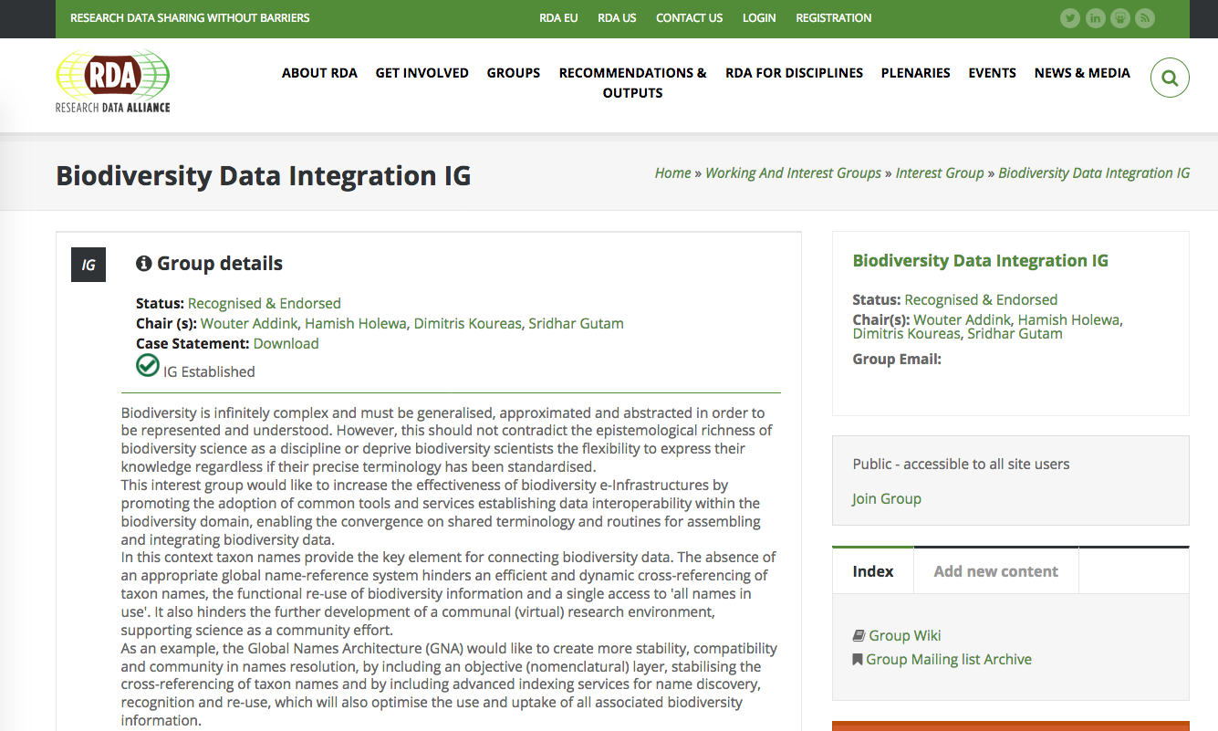

Slide 24
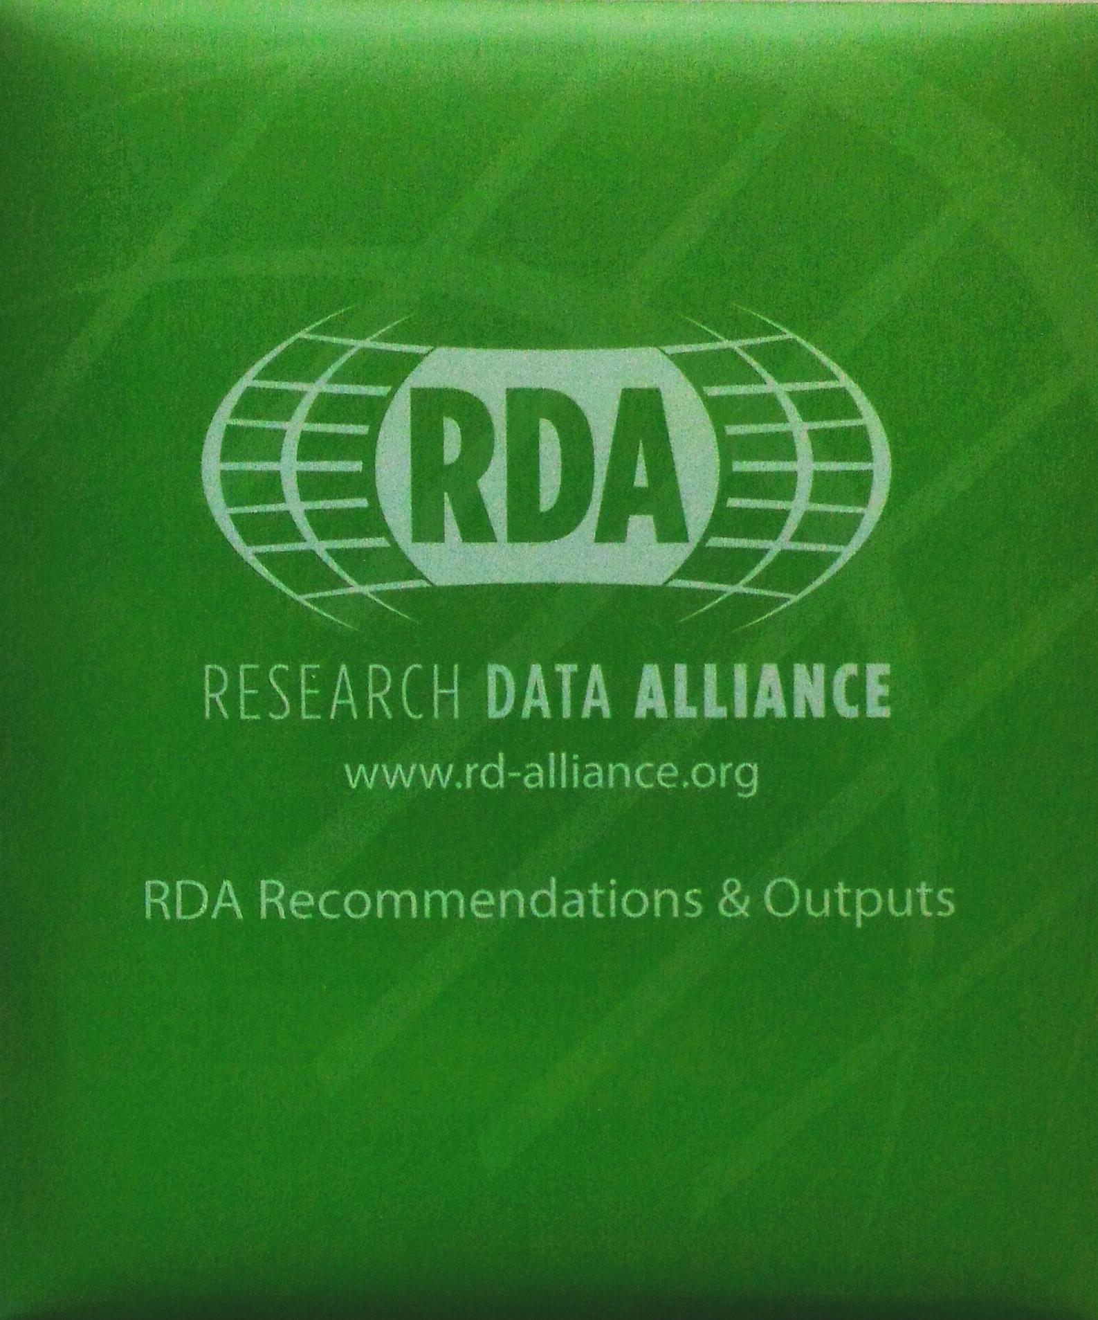
RDA Recommendations & Outputs
THE RDA OUTCOMES LEGEND
Recommendations: are the flagship outputs of RDA. They are RDA’s equivalent of the “specifications” or “standards” that other organisations create and endorse. The process for creating and endorsing these is already defined.
Supporting Outputs: are the outputs of RDA WGs and IGs that are fruit of RDA work, but are not necessarily adoptable bridges. “Upon request”, these sort of outputs go through a community comment period and if no major objections or gaps are identified they get the RDA Brand.
Other Outputs: include workshop reports, published articles, survey results, etc. Anything a WG or IG wants to register and report. Upon request, these are published and discoverable on the RDA website but have no level of endorsement.
CC BY-SA 4.0

Slide 25
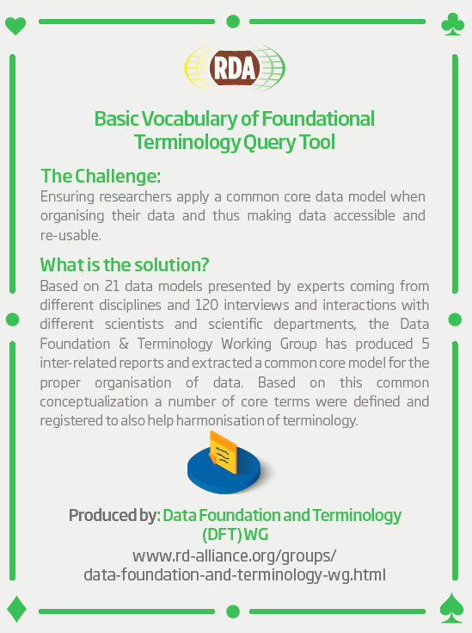
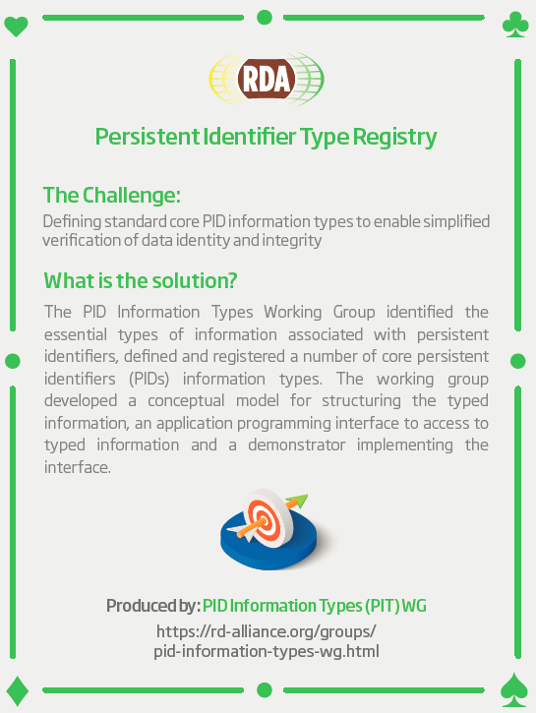
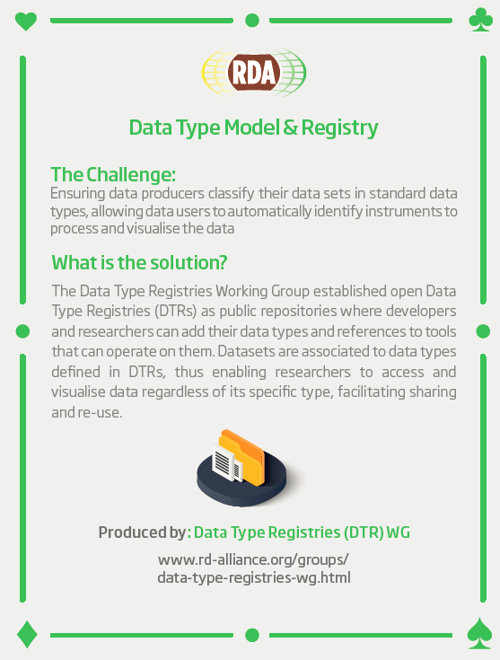
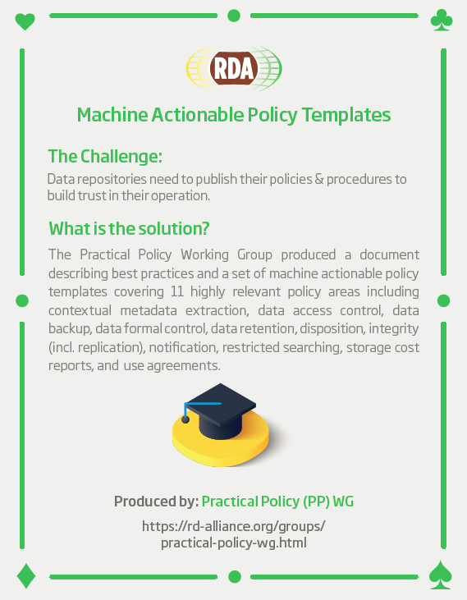
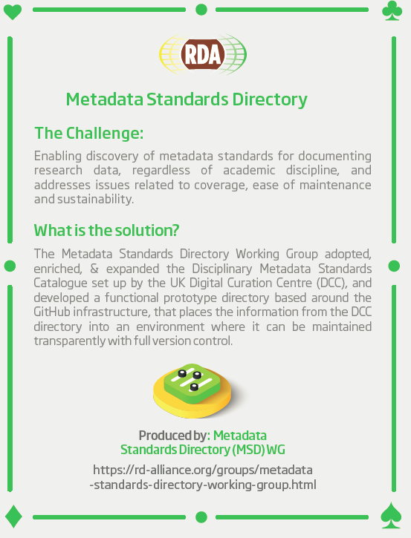
RDA Recommendations & Outputs
Data Foundation & Terminology Recommendations: a model for data in the registered domain.
PID Information Types Recommendations: a common protocol for providers and users of persistent ID services worldwide.
Data Type Registries Recommendations: allowing humans and machines to act on unknown, but registered, data types.
Practical Policy Recommendations: defining best practices of how to deal with data automatically and in a documented way with computer actionable policy.
Metadata Standards Directory Recommendations: Community curated standards catalogue for metadata interoperability
Research Data Collections Recommendations: A comprehensive model for actionable collections and a technical interface specification to enable client-server interaction.
Data Citation Recommendations: defining mechanisms to reliably cite dynamic data
rd-alliance.org/recommendations-and-outputs/all-recommendations-and-outputs
CC BY-SA 4.0

Slide 26
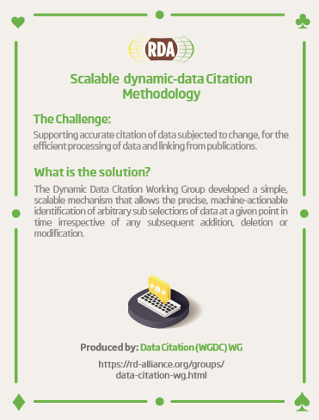
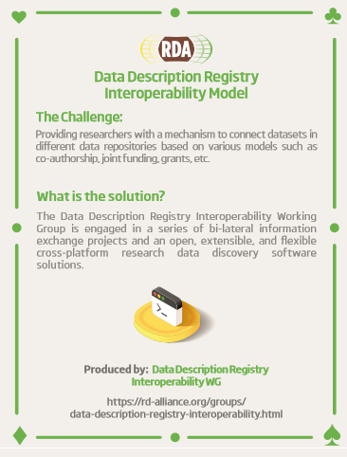
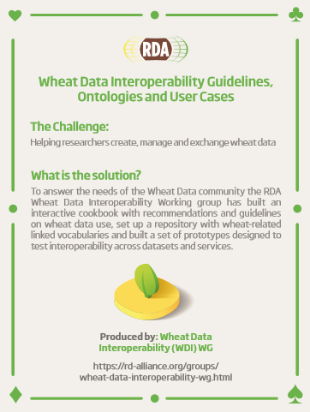
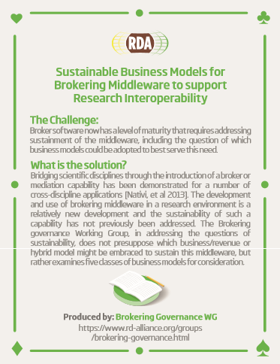
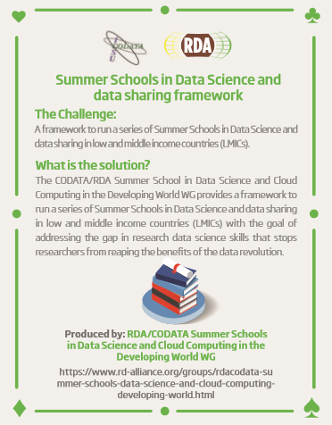
RDA Recommendations & Outputs
Data Description Registry Interoperability Recommendations: solutions enabling cross platform discovery based on existing open protocols and standards
Wheat Data Interoperability Recommendations: impacting the discoverability, reusability and interoperability of wheat data by building a common framework for describing, representing linking and publishing wheat data
Brokering Governance Recommendations: Sustainable Business Models for Brokering Middleware to support Research Interoperability
RDA/CODATA Summer Schools in Data Science and Cloud Computing in the Developing World Recommendations: A framework to run a series of Summer Schools in Data Science and data sharing in low and middle income countries (LMICs)
rd-alliance.org/recommendations-and-outputs/all-recommendations-and-outputs
CC BY-SA 4.0

Slide 27
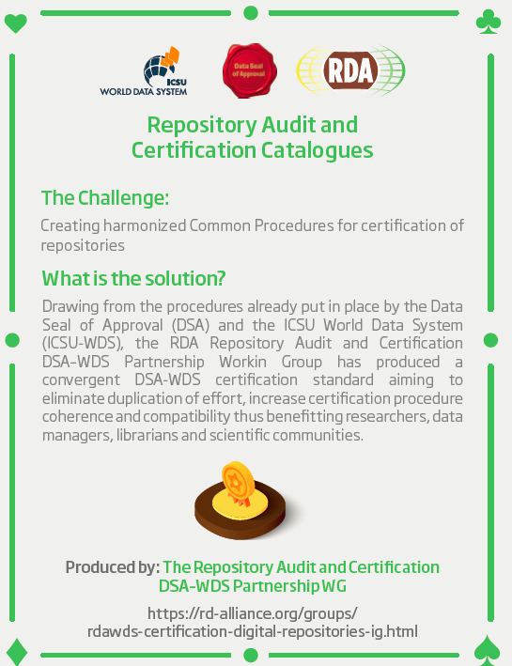
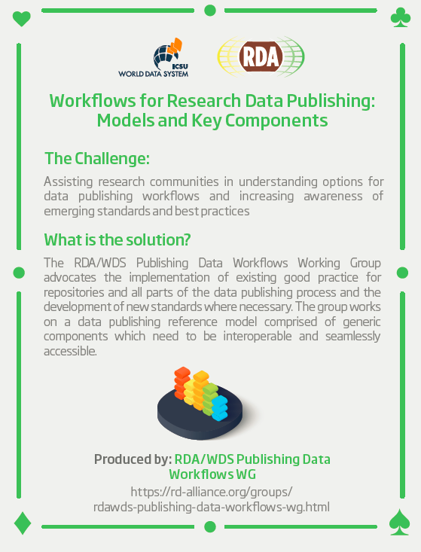
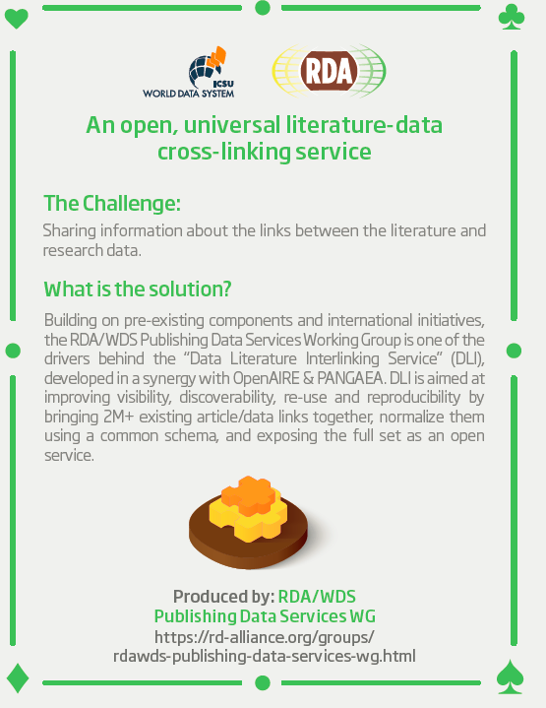
RDA Recommendations & Outputs
Repository Audit and Certification DSA–WDS Recommendations: A convergent DSA-WDS certification standard to help eliminate duplication of effort, increase certification procedure coherence and compatibility thus benefitting researchers, data managers, librarians and scientific communities.
RDA/WDS Publishing Data Workflows Recommendations: enhance the possibilities for greater discoverability and a more efficient and reliable reuse of research data benefitting other stakeholders like publishers, libraries and data centres.
RDA/WDS Publishing Data Services Recommendations: A universal interlinking service between data and the scientific literature. The Scholix initiative a high level interoperability framework for exchanging information about the links between scholarly literature and data. It aims to build an open information ecosystem to understand systematically what data underpins literature and what literature references data.
BioSharing Registry Recommendations: Data repositories, standards and policies in the life, biomedical and environmental sciences
rd-alliance.org/recommendations-and-outputs/all-recommendations-and-outputs
CC BY-SA 4.0

Slide 28
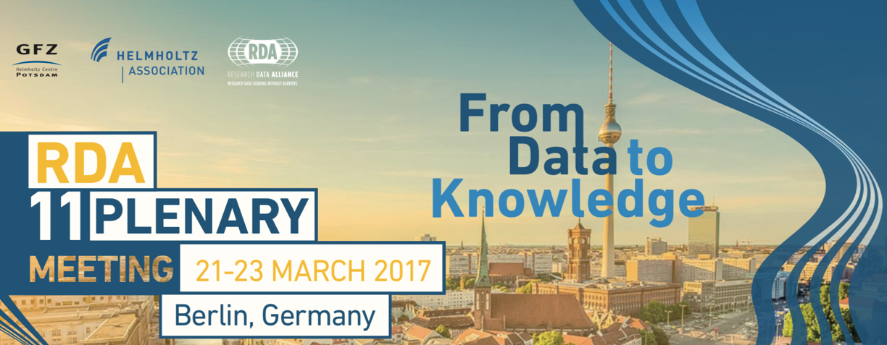
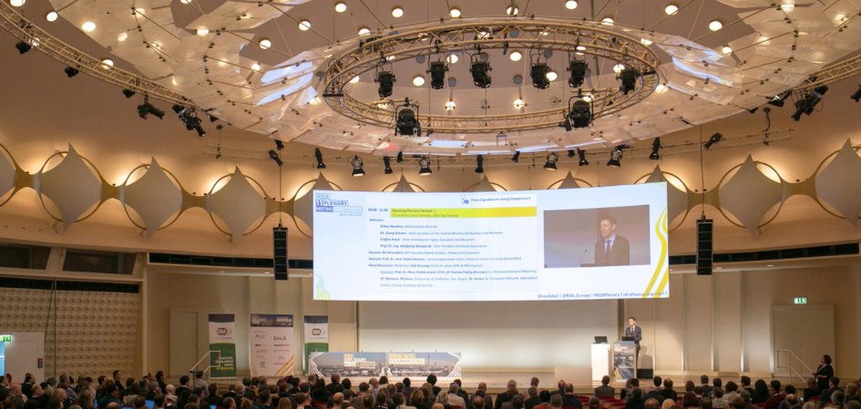
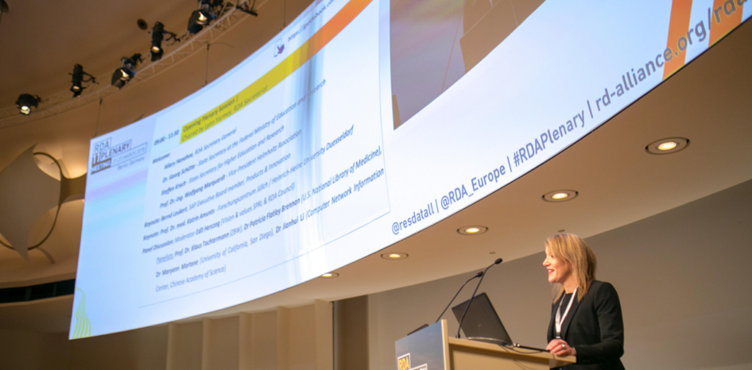
83 Breakout meetings
19 Working Groups
37 Interest Groups
12 Joint Working & Interest Groups
15 Birds of a Feather
4 Final Recommendations presented
3 New Recommendations
Collaboration projects with AGU and ISO on adoption and impact metrics
74 posters applications
661 participants from 41 countries
https://rd-alliance.org/plenaries/rda-eleventh-plenary-meeting-berlin-germany
rd-alliance.org/plenaries
CC BY-SA 4.0

Slide 29
Digital Frontiers of Global Science
To find out more visit:
https://www.rd-alliance.org/plenaries/rda-twelfth-plenary-meeting-part-international-data-week-2018-gaborone-botswana
rd-alliance.org/plenaries
CC BY-SA 4.0

Slide 30
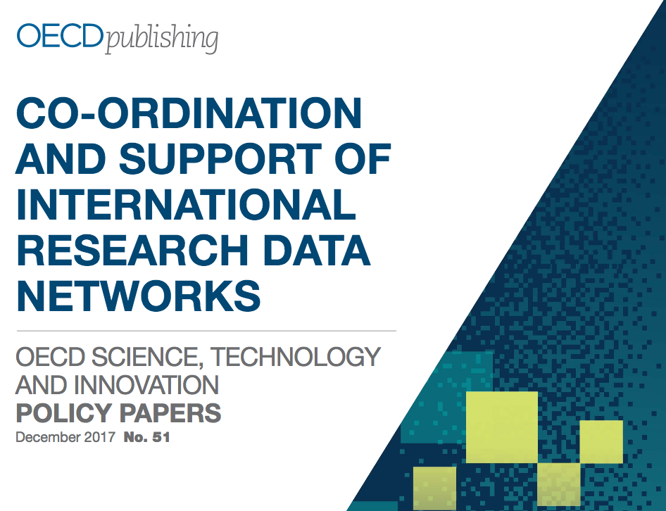
https://doi.org/10.1787/e92fa89e-en

Slide 31
Abstract
International research data networks are critical for progress in many scientific domains and underpin efforts to promote open science. At the same time, many of these networks are fragile and the responsibilities for their support and performance are frequently distributed across a variety of different actors. This report explores the challenges and enablers for the effective functioning of international research data networks. It analyses the diversity and complexity of these networks, and issues such as governance and funding, in a selection of 32 cases. It includes a set of policy recommendations as a basis for building the shared understanding that is necessary to develop effective and sustainable international research data networks.

Slide 32
GBIF Participants
Donald Holbern, interviewed
Tim Hirsch, attended 30-31 March 2017 workshop in Brussels

Slide 33
OECD Recommendations
Responsible national authorities should be identified and work toward common definitions of, and agreements on, open data.
Governments need to work toward commonly agreed and enforced legal and ethical frameworks for the sharing of different types of public research data.
All stakeholders need to recognise international research data networks as a critical part of the generic infrastructure for open science.
Responsible national and international authorities must include data networks in long-term strategic planning and support processes for research infrastructure.

Slide 34
OECD Recommendations
In establishing, developing, operating, and supporting international data networks the following “organisational” aspects should be taken into account:
Networks should have a clearly defined user and data provider community. At the same time potential requirements of new users, e.g. in terms of interoperability, should not be ignored.
Networks should have a clear understanding of how they relate to other networks and how they fit into the global research and data sharing landscape.
Different governance models can succeed, but there is need to define clearly what is to be governed and to involve the data users and providers.
Roles and responsibilities across a network, e.g. for data curation versus service provision, must be clearly defined and, where possible, data champions identified
The necessary level of standardisation needs to be clearly defined taking into account user requirements and the need to maintain an appropriate balance of autonomy amongst network nodes and central control.
Objective and transparent mechanisms for network assessment should be based on standard quality management frameworks and certification of participating data repositories.
Consideration needs to be given to regional differences in capacity— infrastructure and human resources—and in culture, community needs and expectations.

Slide 35
OECD Recommendations
Funders and host institutions should view internationally coordinated data networks as a long-term strategic investment and support them and engage with them accordingly.
Networks should have clear business models, including value propositions and measures of success that are relevant to their different stakeholders and these measures should be monitored.
Funders should actively participate in relevant international discussions and forums to improve long-term functioning, support and coordination of data networks.

Slide 36
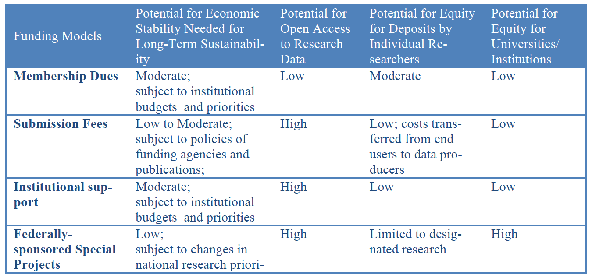
Business Models and Sustainability
“Sustaining Domain Repositories for Digital Data: A White Paper,” Ember & Hanisch, eds. (2013).

Slide 37
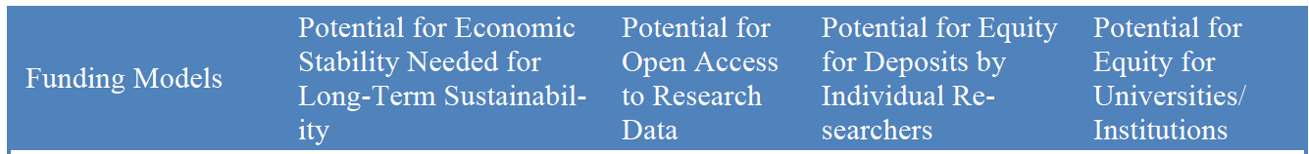
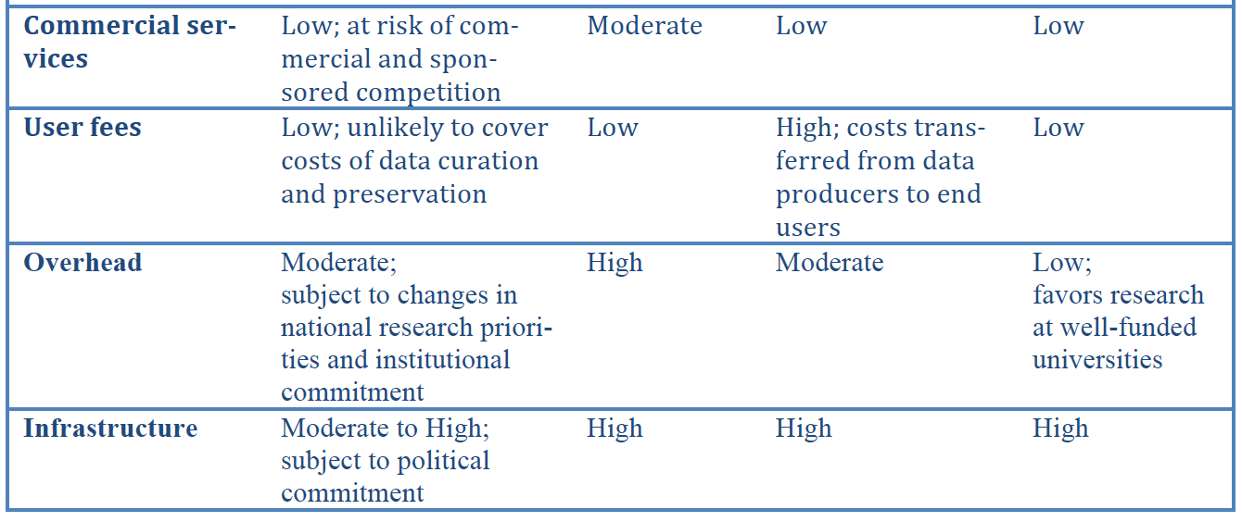
Business Models and Sustainability
http://datacommunity.icpsr.umich.edu/sites/default/files/WhitePaper_ICPSR_SDRDD_121113.pdf

Slide 38
Business Models and Sustainability
RDA/WDS Interest Group: Publishing Data Cost Recovery for Data Centers
Funding models examined:
Structurally funded
Data access charges
Data deposit fees
Supported by host institution
Diversified
Project funding
~40% of organizations interviewed were uncertain about future funding
Final report (February 2016): https://rd-alliance.org/system/files/documents/Income_Streams_for_Data_Repositories-FINAL-160210.pdf

Slide 39
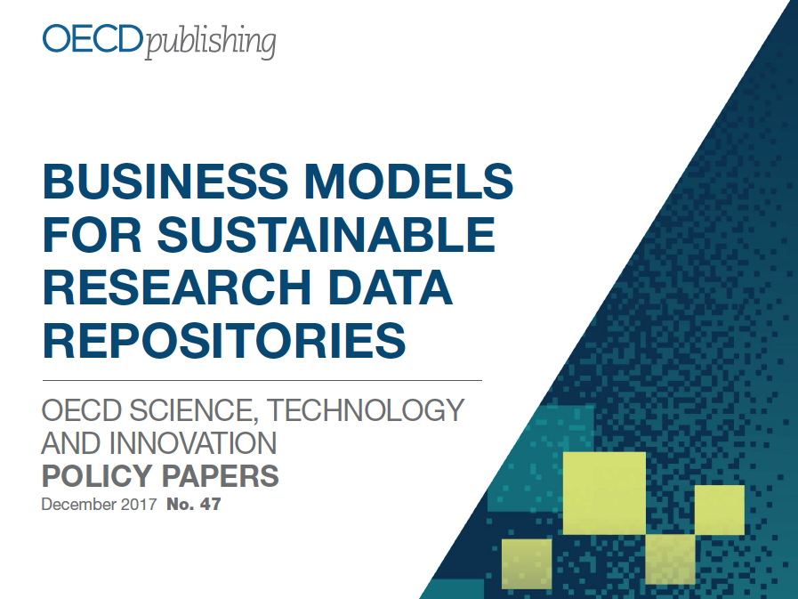
Business Models and Sustainability
https://doi.org/10.1787/302b12bb-en

Slide 40
Business Models and Sustainability
OECD study used same categories of revenue as RDA
“For research data repositories, all of these revenue sources can, and often do, come from the public purse and, directly or indirectly, out of research and higher education budgets. Thus, at a national research system level, the meta-question is how best to allocate this funding, including which entities should have responsibility for it and what selection mechanisms should they use?”

Slide 41
OECD Recommendations
All stakeholders should recognise that research data repositories are an essential part of the infrastructure for open science.
All research data repositories should have a clearly articulated business model.
Policy makers, research funders, and other stakeholders need to consider the ways in which data repositories are funded, and the advantages and disadvantages of various business models in different circumstances.
Research data repository business models are constrained by, and need to be aligned with, policy regulation (mandates) and incentives (including funding).
In the context of financial sustainability, opportunities for cost optimisation should be explored in order to be able to effectively manage digital assets over time.

Slide 42
Discover, Access, Interoperate
Why?
Support FAIR* principles: Findable, Accessible, Interoperable, Re-usable
Assure maximum return on national investment in basic research
Demonstrate best practices
Address reproducibility “crisis”
US OMB, OSTP directives; FASTR legislation
*Wilkinson et al. 2016, Nature Scientific Data, DOI: 10.1038/sdata.2016.18

Slide 43
Registries

Slide 44
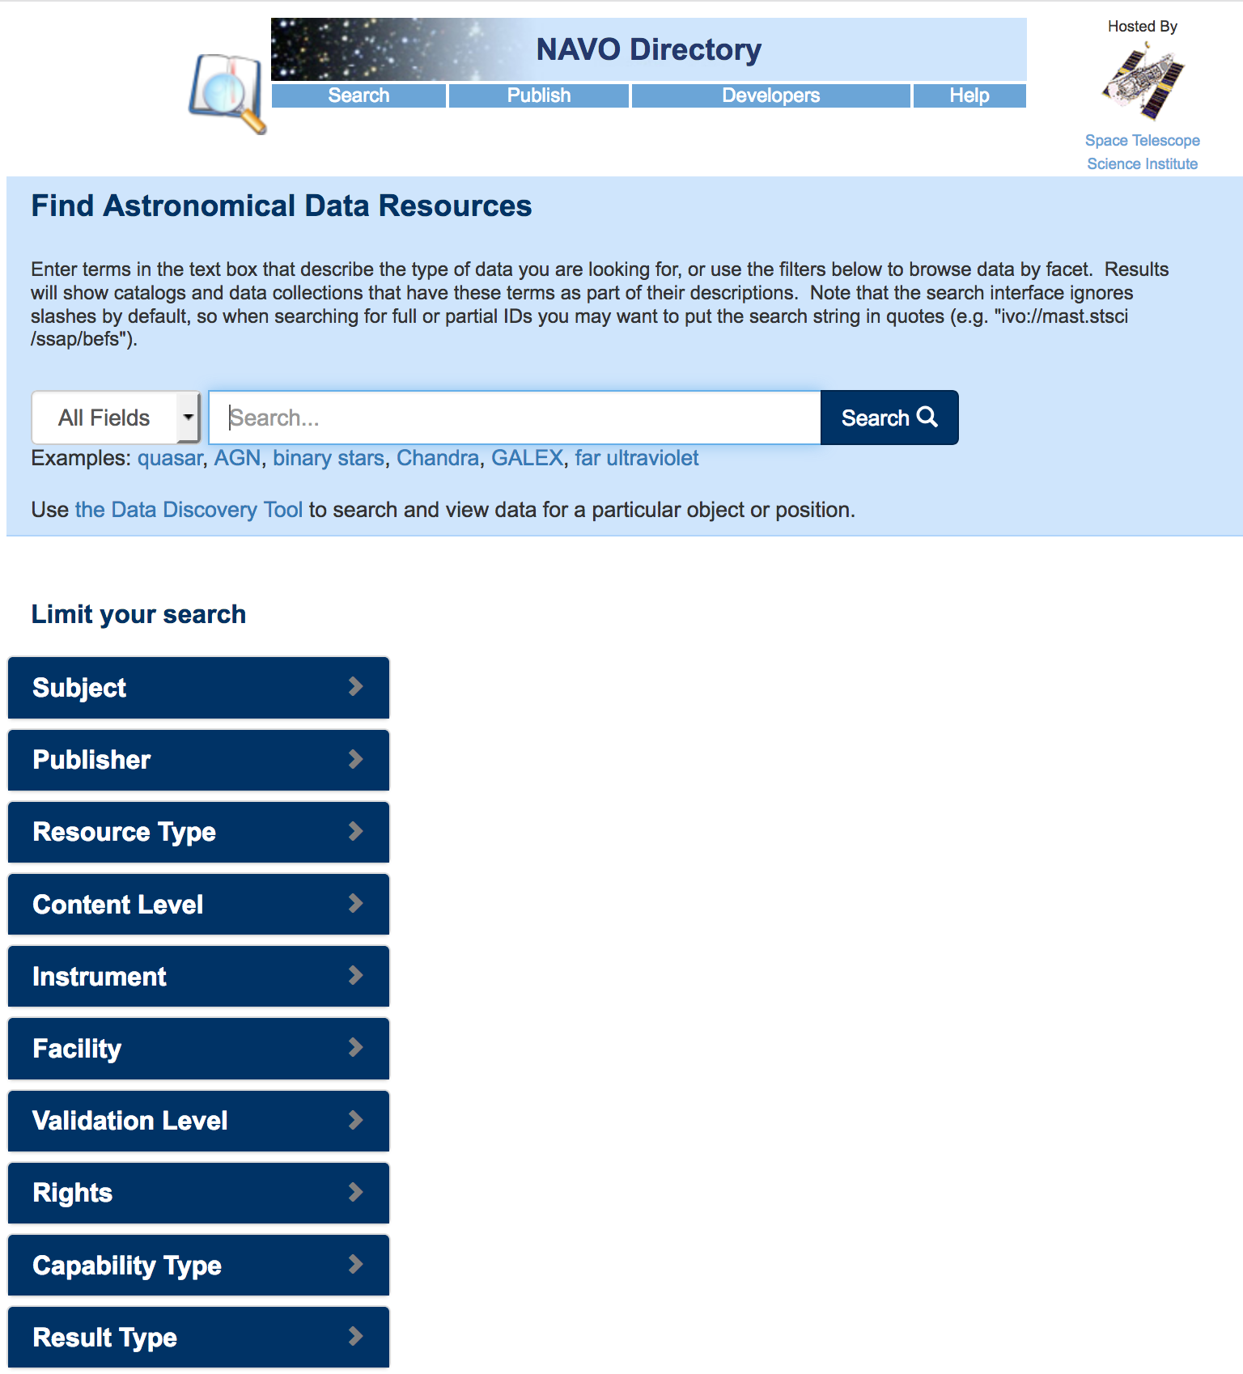
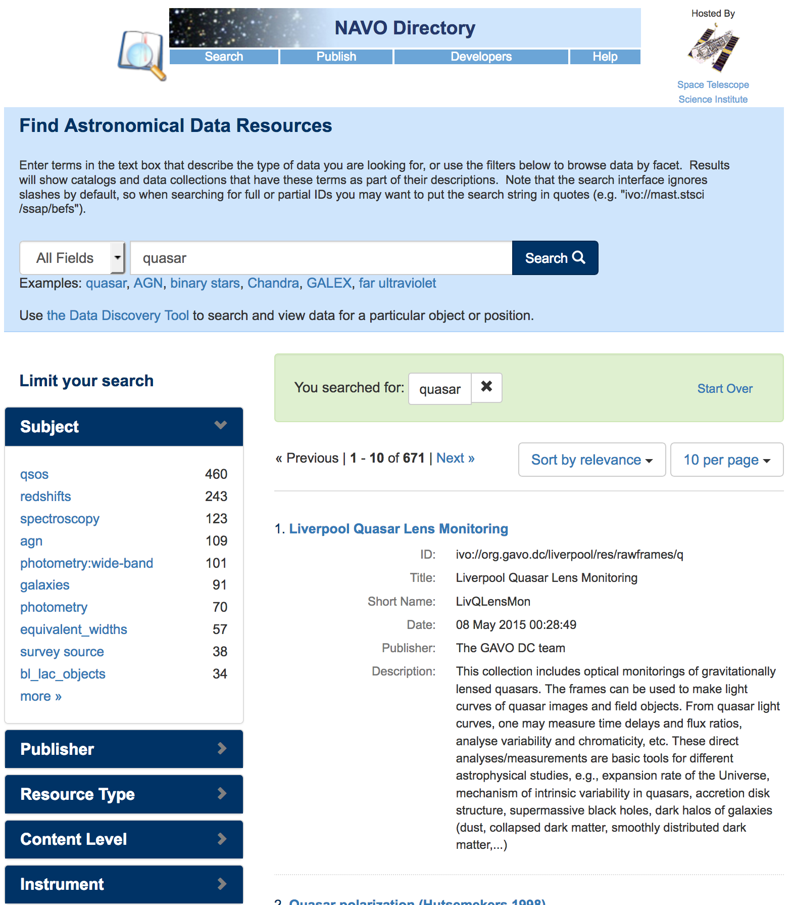
Virtual Observatory
IVOA

Slide 45
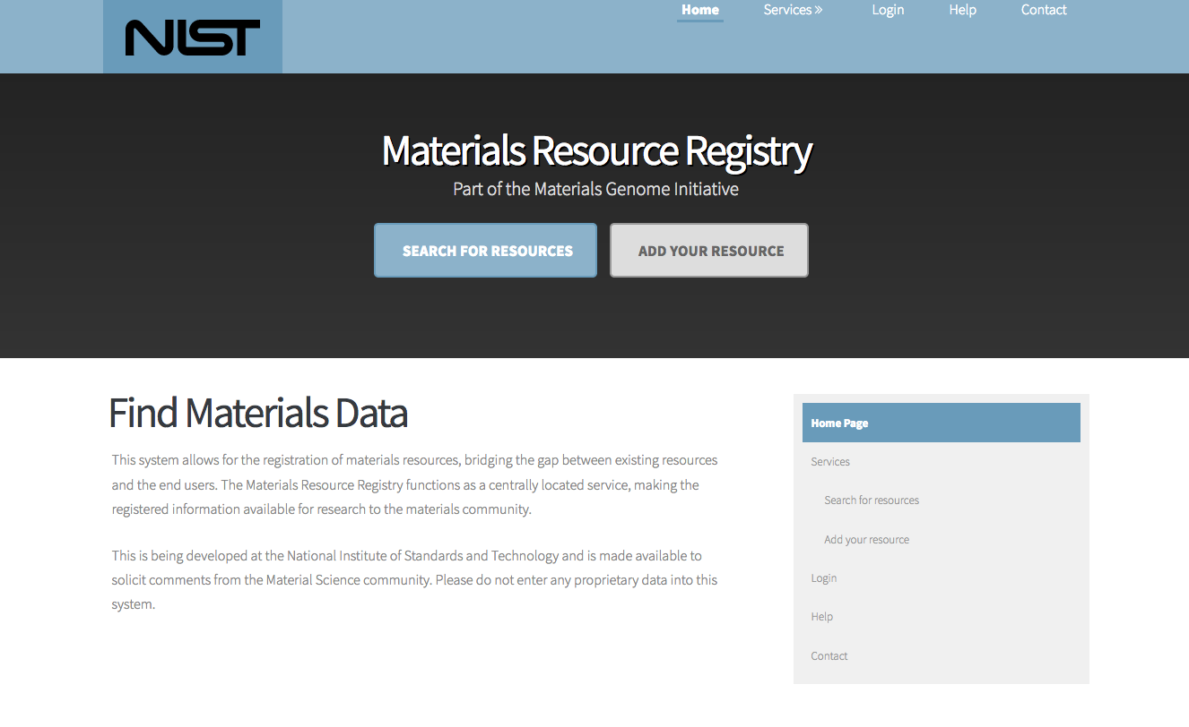
Materials Resource Registry
RDA
https://materials.registry.nist.gov/

Slide 46
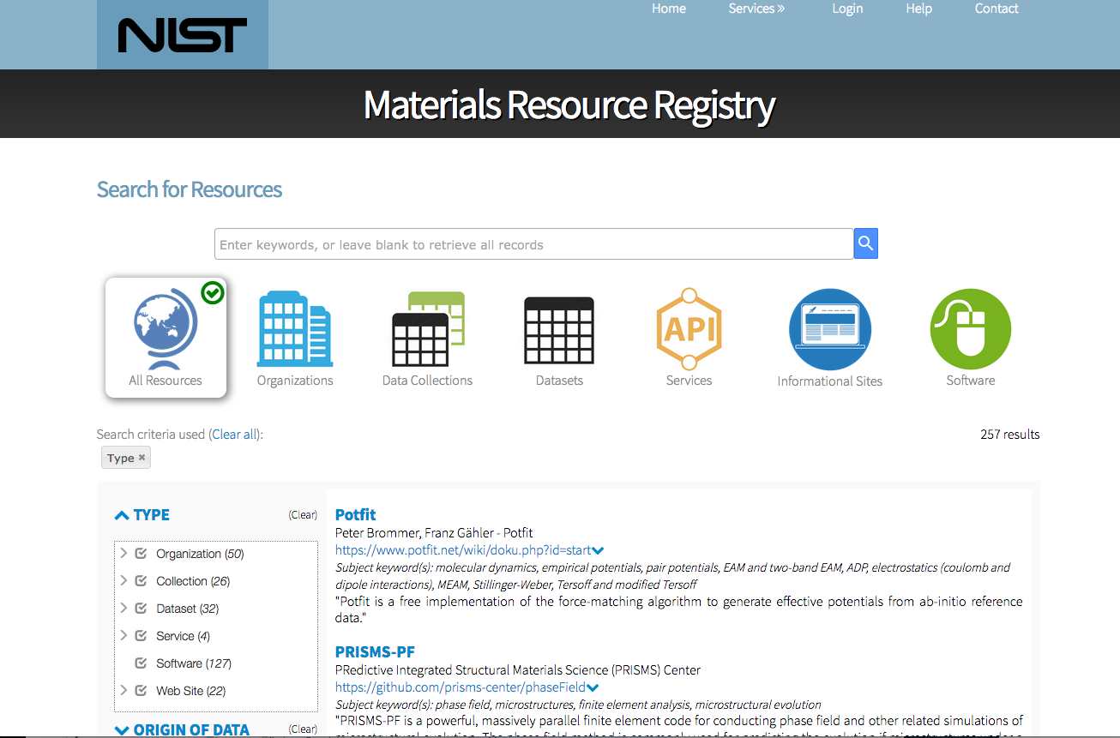
https://materials.registry.nist.gov/

Slide 47
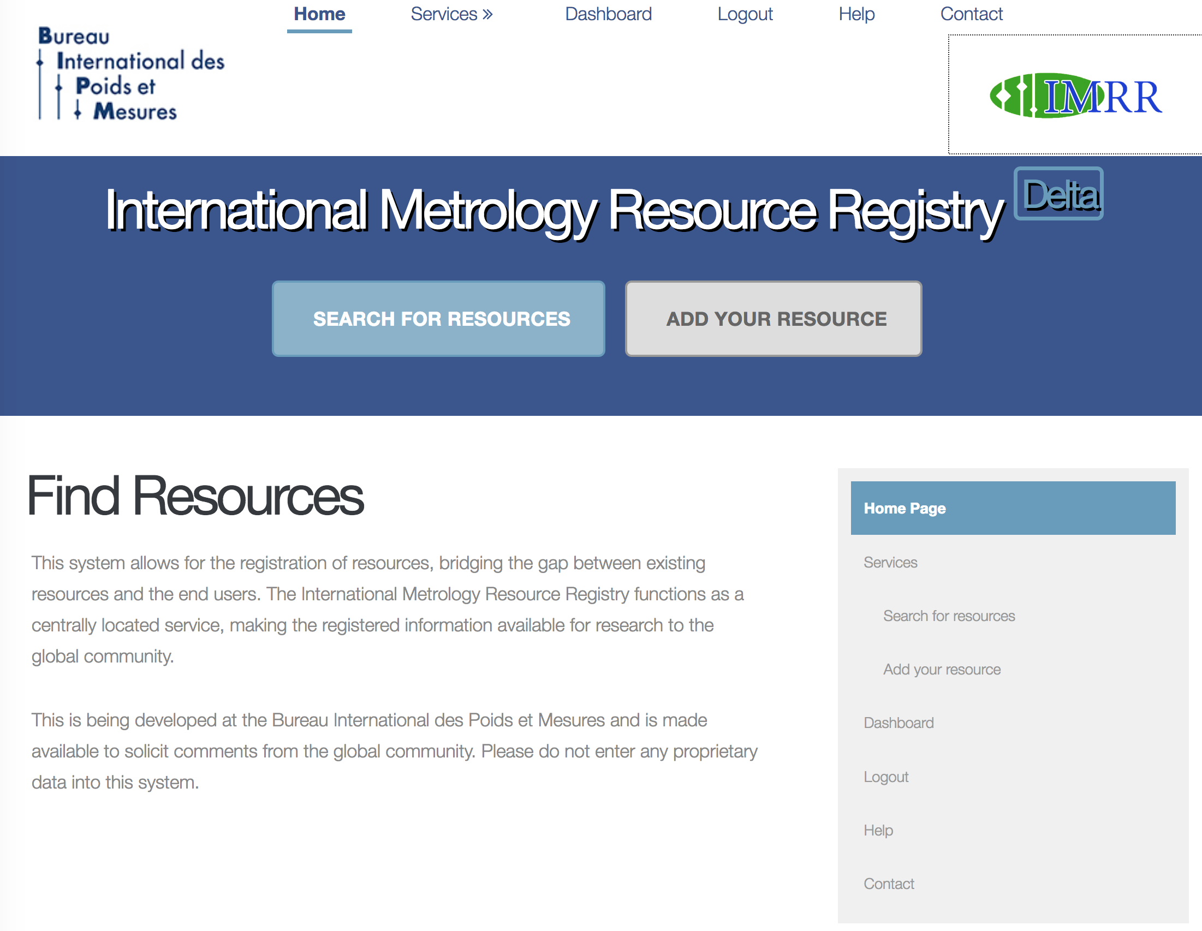
http://imrr.bipm.org/
NMIs

Slide 48
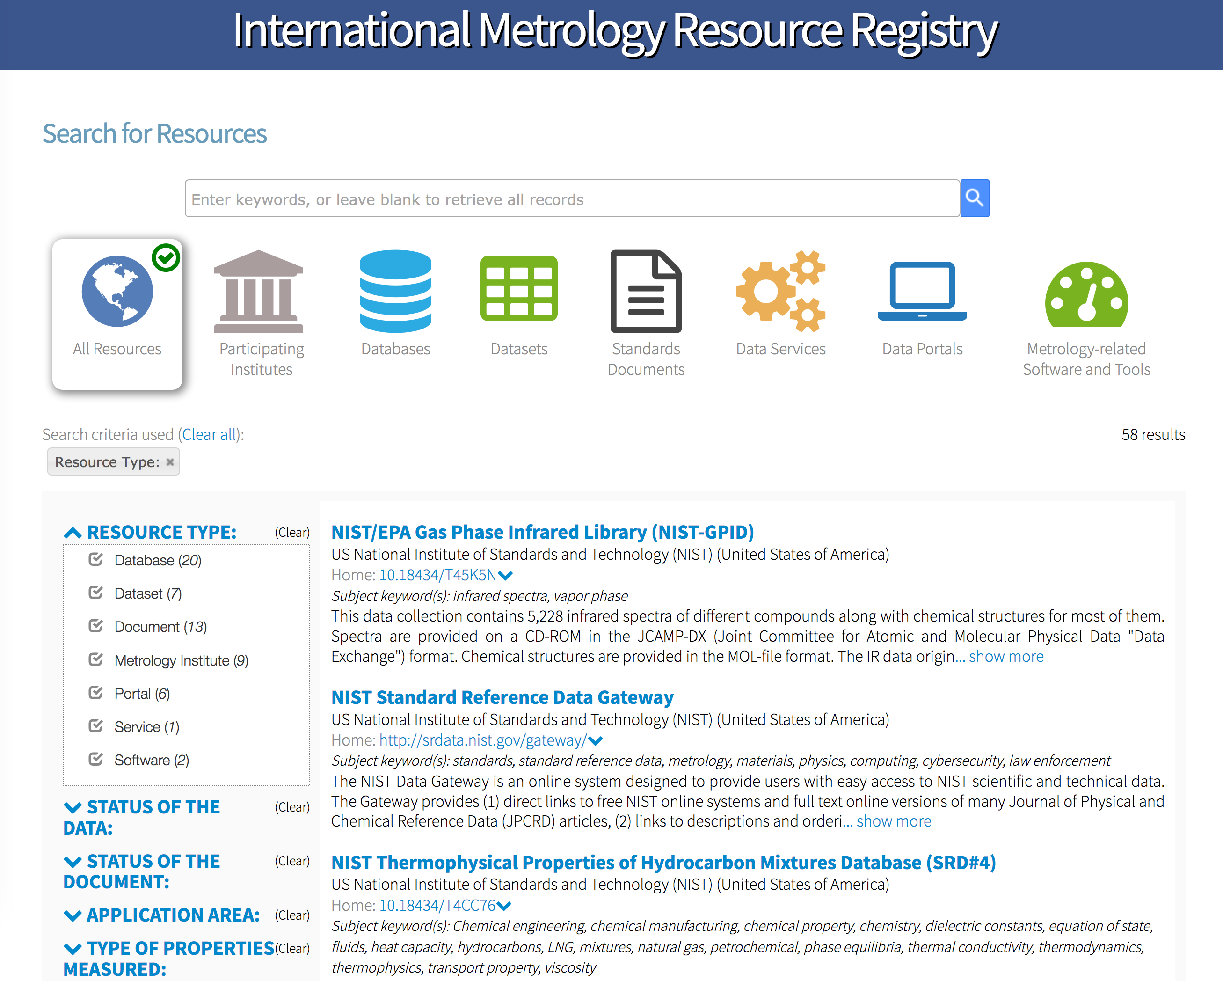

Slide 49
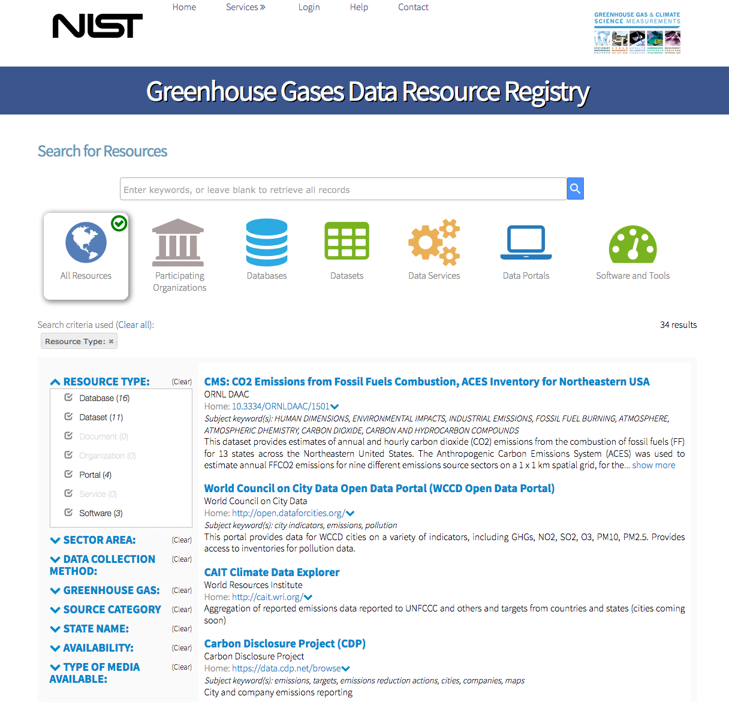
GHG
collaboration

Slide 50
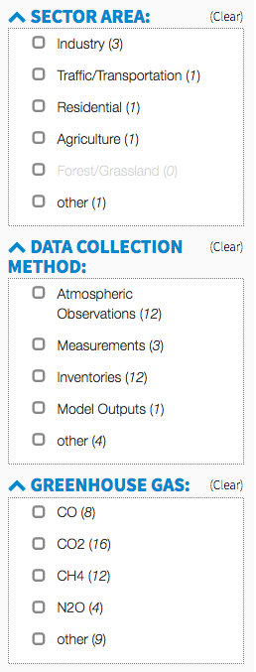
GHG Metadata

Slide 51
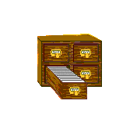



Federated Architecture
Full
Searchable
Registry
Resource
Registry
harvest
(pull)
replicate
OAI/PMH
Local
Publishing
Registry
Full
Searchable
Registry
major
data
providers
search
queries
Local
Publishing
Registry
Users,
applications

Slide 52
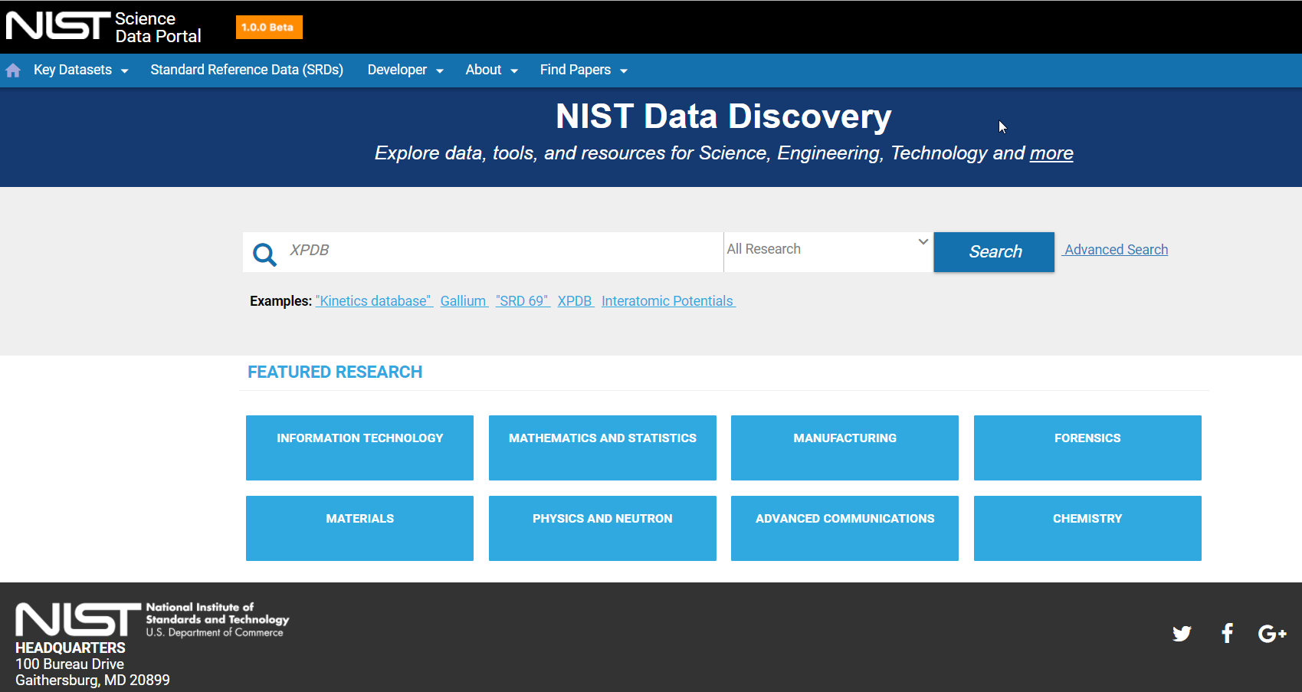
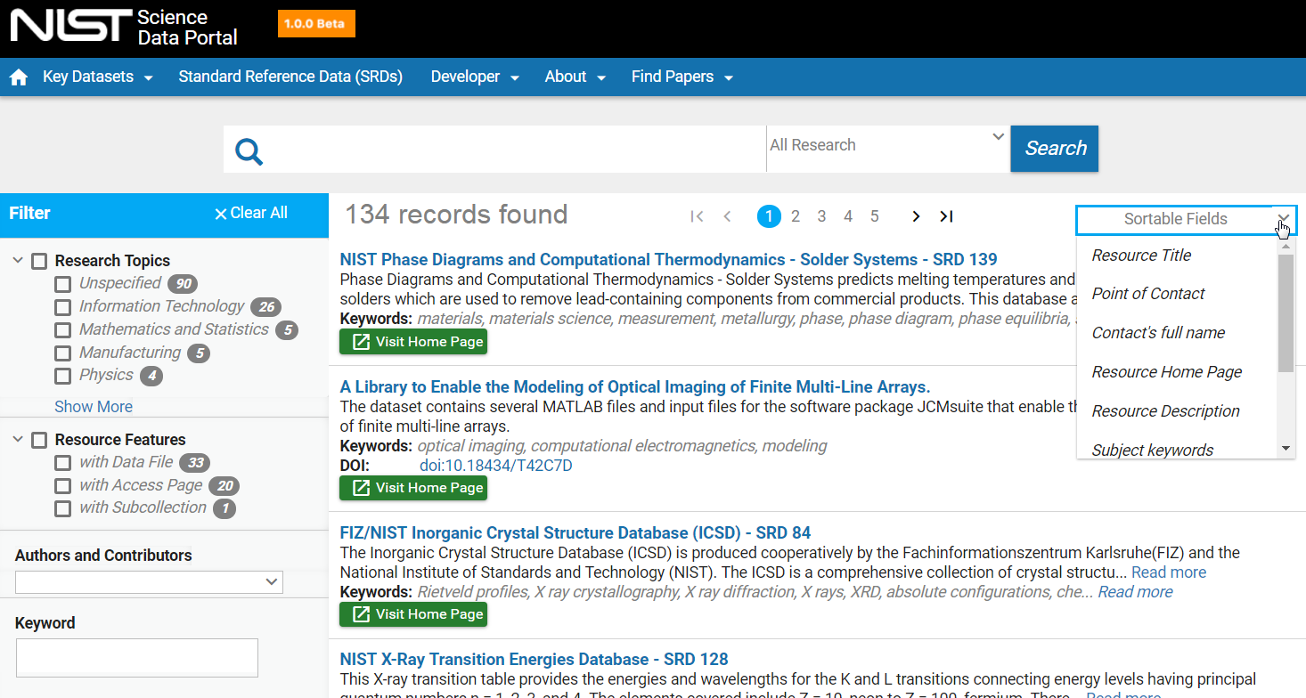
Discovery for NIST Public Research Data
Search NIST public data records
View metadata
Filter results
Access data files, metadata
APIs allow interoperability with client tools
Records link to Public Data Repository

Slide 53
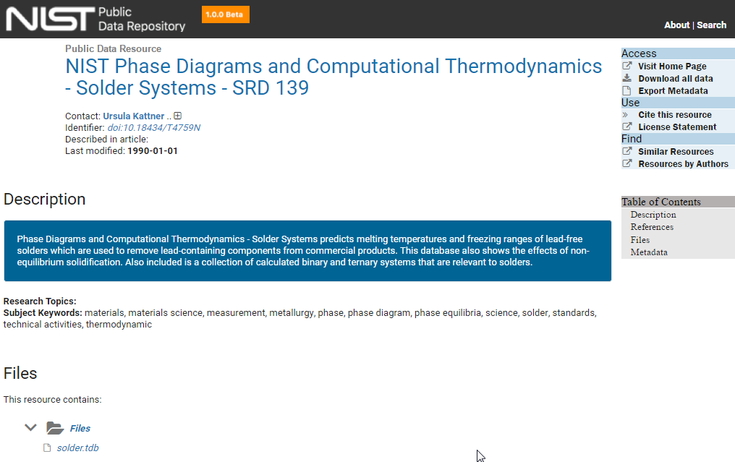
NIST Public Data Repository – Basic Landing Page

Slide 54
Research Data Infrastructure

Slide 55

Metadata Standards

Slide 56
Inspiration
Data management practices in astronomy, and the VO in particular, have inspired similar efforts in other fields
Space science/space physics VxOs (VSO, VHO, VMO, VITMO)
Materials science
Metrology
Ecology/environmental science
Life/bioscience
Neuroscience
Other communities are envious of astronomy’s global data format, FITS
Other fields must contend with myriad of formats, many proprietary
Also similar challenges, such as interoperability and semantic standards
Independent development of similar architecture

Slide 57

Materials Genome Initiative

Slide 58


Environmental Science

Slide 59


Life Sciences

Slide 60

Neuroscience
Sean Hill, European Brain Initiative…

Slide 61


Neuroscience

Slide 62
Conclusions
Core VO design/architecture is strong and has been adopted by major data providing organizations in astronomy; now informing data system design in other fields
Federated, distributed systems have many benefits…
Scalability
Flexibility
Distributed curation by experts
Communities can build on core infrastructure
…and challenges
Consensus must be reached on metadata standards and realistic goals for interoperability

Slide 63



https://www.nist.gov/mml/odi

